Slide 1
Synthetic Morphogenesis
Program cell with specific cell size

Slide 2

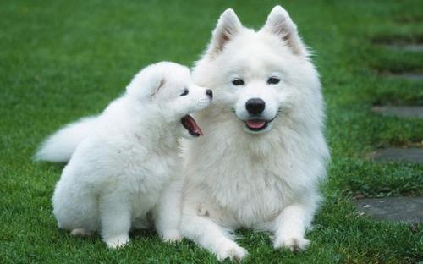
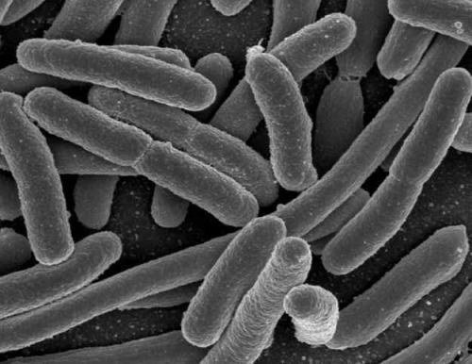
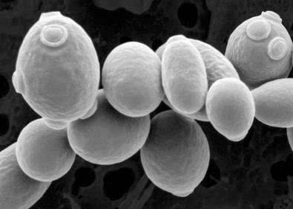
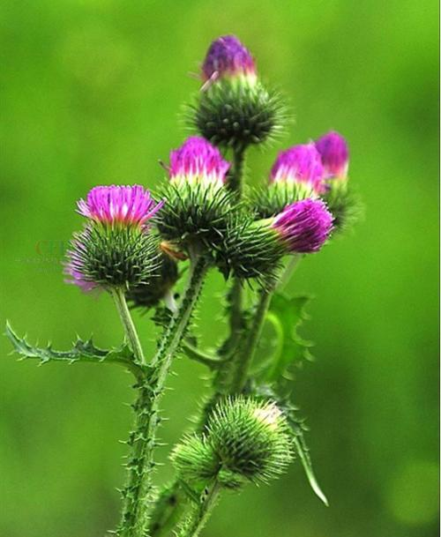
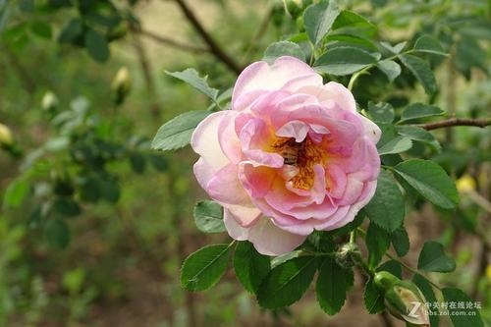
Evolution pathway
E.coli
Notes:
From simple single cell to organism with well-organized, complicated structure

Slide 3






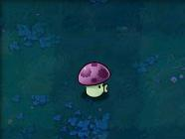
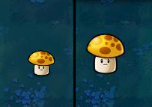

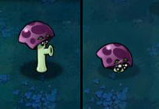




When we encounter difference
Why
How
Notes:
As a scientist we want to know which cause the difference between different pattern? – developmental biology– knowledge base
What an engineer want to know is that: to which extent could we reconstruct or mimic such process? –synthetic morphogenesis – tools and principles for engineering
Today we are more likely to talk about, how to do that.

Slide 4
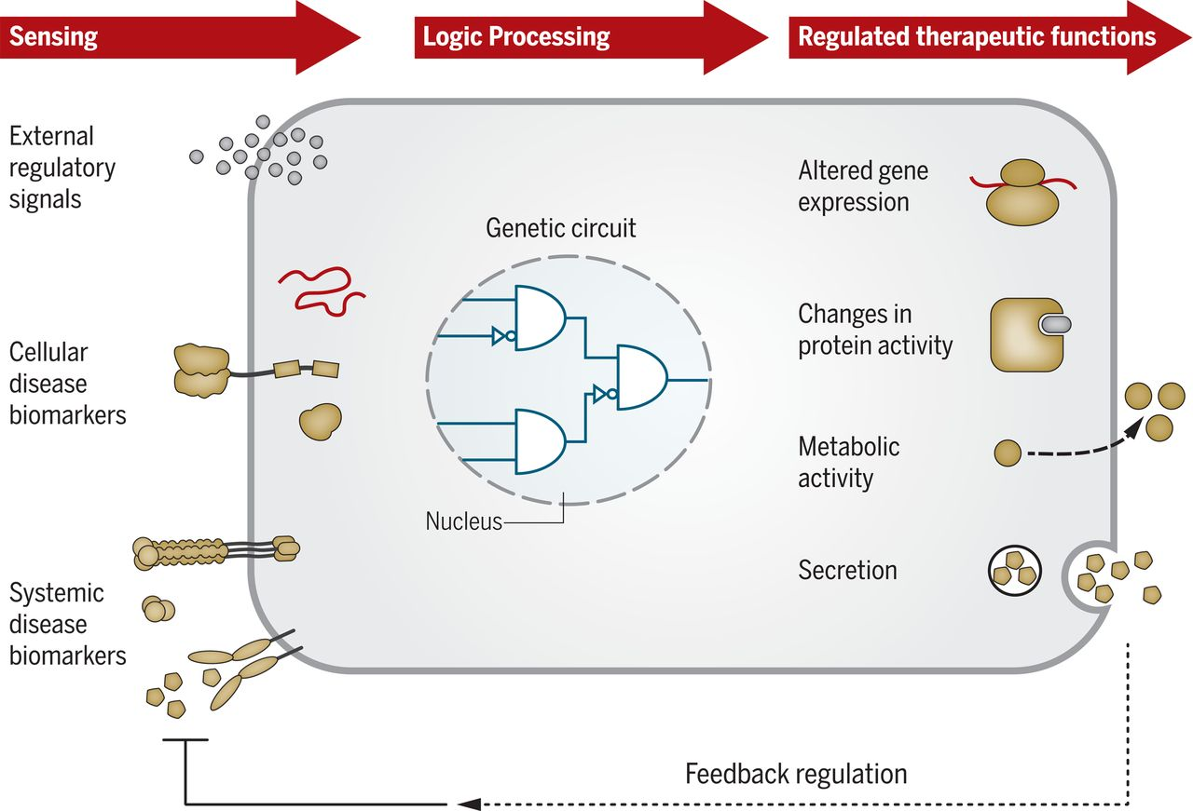
Traditional synthetic biology
Notes:
Input-output signal process
More focus on cellular behavior

Slide 5
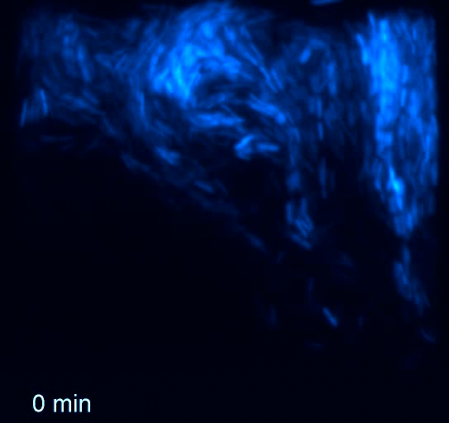
Traditional synthetic biology -- bulk property
Danino, T., Mondragón-Palomino, O., Tsimring, L., & Hasty, J. (2010). A synchronized quorum of genetic clocks. Nature, 463(7279), 326.
Notes:
More focus on cellular process, and measure the bulk property. Even for group behavior such as quorum sensing, we observe the bulk property—parameters can be used as output is the signal concentration

Slide 6
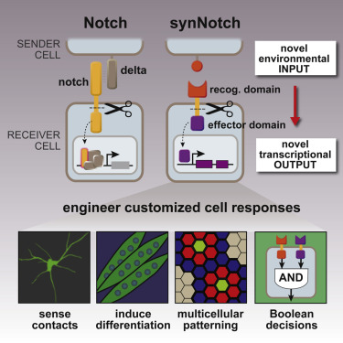
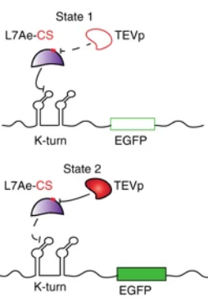
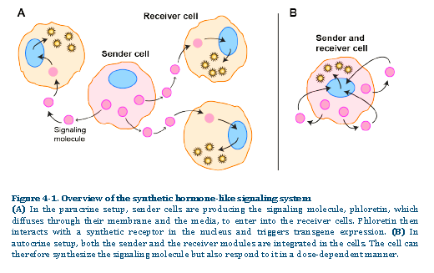
State of art
Morsut, L., Roybal, K. T., Xiong, X., Gordley, R. M., Coyle, S. M., Thomson, M., & Lim, W. A. (2016). Engineering customized cell sensing and response behaviors using synthetic notch receptors. Cell, 164(4), 780-791.
Cella, F., Wroblewska, L., Weiss, R., & Siciliano, V. (2018). Engineering protein-protein devices for multilayered regulation of mRNA translation using orthogonal proteases in mammalian cells. Nature communications, 9(1), 4392.
XAVIER DUPORTET, “Developing new tools and platforms for mammalian synthetic biology: from the assembly and chromosomal integration of complex DNA circuits to the engineering of artificial intercellular communication systems”
PhD diss., INRIA Rocquencourt and Massachusetts Institute of Technology,14 November 2014.
Notes:
Recent development make it possible to reconstruct cells with refined structure:
Cell cell interface structure
More useful tools in higher chassis organism—mammalian cell
Different kinds of signal system (direct communication and long range communication)

Slide 7

How to design a cat?
Still a long way to go

Slide 8

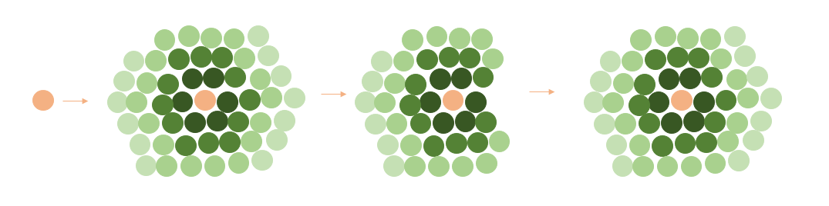
Aim: Size control and self-healing
Notes:
One simple aim – size control
Very common, fundamental and important for organism development
Redefine aim: from one single cell, development into the a group of cell, hold size, and recover once some of them are impaired

Slide 9
Decouple into 3 parts – design overview
Mother cell
Daughter cell
Asymmetric cell division
Dilute plasmid
Non-dilute plasmid
Sender
Cell communication
Receiver
Positive feedback
Programmed cell death
Cell death
Non-dilute plasmid
Receiver
Cell death
Notes:
Decouple
Get inspiration from nature and decouple into 3 parts:
Asymmetric cell division from development and stem cell: generate 2 types of cell fundamental for more genotype/different gene expression spectrum (More refined structure)
Cell to cell communication for information exchange: deliver group size info (sensor)
Control of cell death and growth – function on size, executer (output)

Slide 10



Morpheus
Notes:
Morpheus modeling:
Diffusion and contact

Slide 11
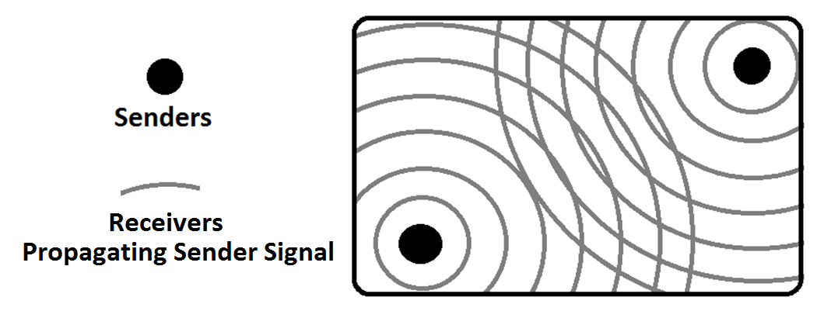
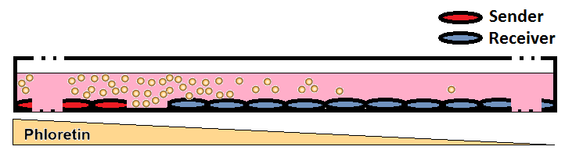
Experiment validation
Signal communication
Plasmid dilution
Notes:
Web lab execution
Signal communication
Plasmid dilution

Slide 12
Phloretin system
McbR G4 operator
CMV minimal promoter
PRMPv10
TtgR mut operator
NeonGreen
hef1a_MBCR-NESVP16NLS
hef1a_tTgR-KRAB
phef
McbR activator
phef
TtgR-KRAB

Slide 13
Plasmid construction

Slide 14
Experiment results

Slide 15
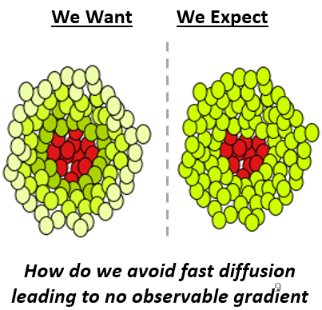
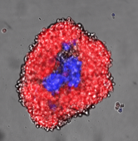
Follow-up experiment(By jesse)
Sorted Receivers
Stable HEK Senders

Slide 16
Discussion

Slide 17
Plasmid dilution

Slide 18
Plasmid dilution

Slide 19
SV40 system

Slide 20
Plasmids setup

Slide 21
Experiment flowchart

Slide 22
Results

Slide 23
Results

Slide 24
Results

Slide 25
Results

Slide 26
Discussion

Slide 27
Conclusion and review

Slide 28
Parameter validation
Notes:
If have time
Time phase seperation

